Slide 1
Game ideas

Slide 2
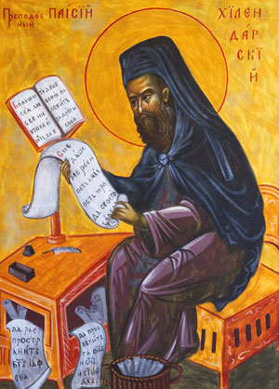



The plot :DD

Slide 3
old people win the lottery and decide to go around the world (Mr. and Mrs. Worldwide)
You have travel blog and travel and update the blog and live :D (http.world)
Traveling circus 😐
The hunt (omg u are so evil, that the whole world is hunting u down and looking for u, good luck :D)

Slide 4
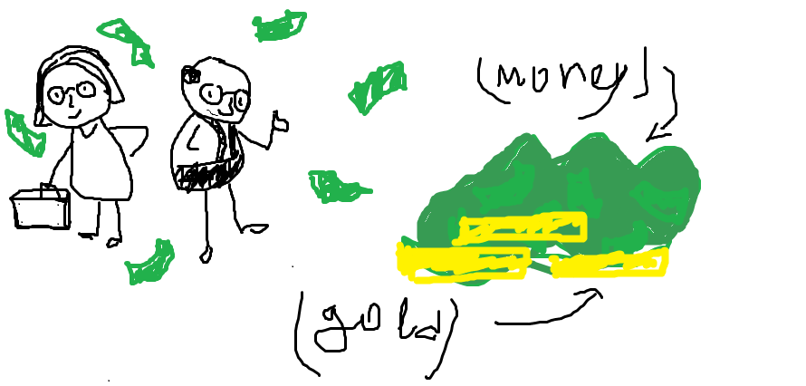

Mr. and Mrs. Worldwide
They travel around with the limited money they have (visit places from with they can buy souvenirs and other things like food pillows(which would give them bonuses))

Slide 5

THE HUNT
You have limited money(yes again), (and time??) and u have to get to your old friend, who lives in another Poland. So to get there you have to change your identity, hide when needed and have common knowledge of geography abd

Slide 6
Travel blog
We need ideas if we gonna use that one

Slide 7
Traveling circus 😐
We need ideas if we gonna use that one, but it’s kinda mehhh so u know

Slide 8

G

Slide 9

How the game is gonna be played
You are asked some random questions about the country you are in
Some kind of subway game

